Slide 1
Liquidation
prevention system
Abhishek Malik
Akshay Gupta

Slide 2
Tech Used
Chainlink
Keeper
Data Feed
External Adapters
Node Operator
Avalanche C-Chain
Snowtrace API
Trader Joe
Anomaly Detection Model: Isolation Forest
Twilio

Slide 3
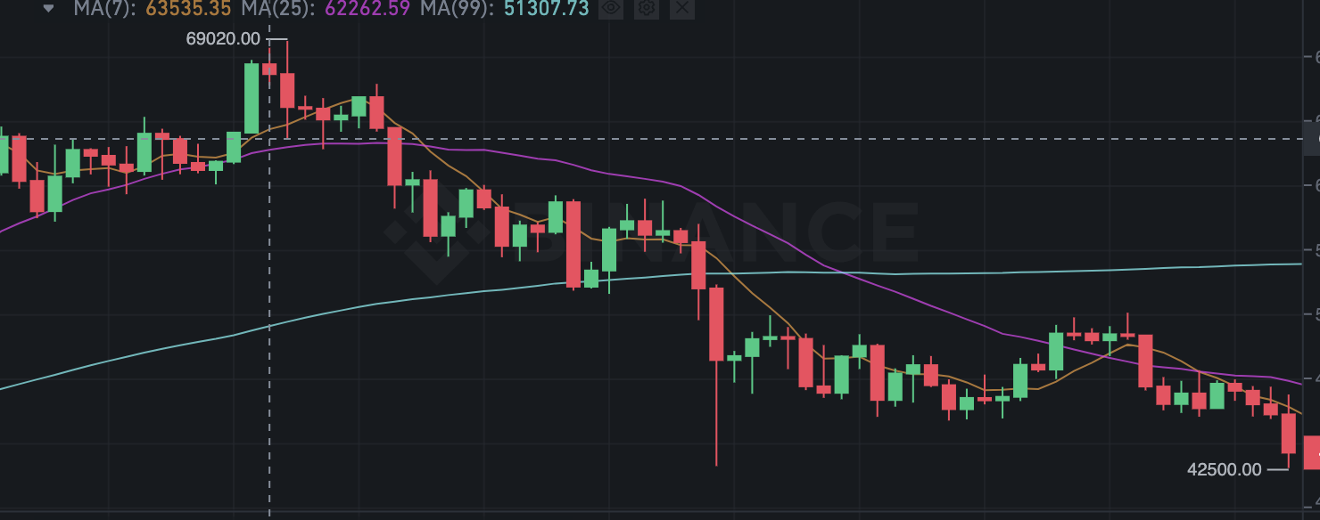
Liquidations are costly
Every now and then we see a market crash
These are intensified due to liquidations
Check out what happened on Dec 4, 2021

Slide 4
Solution: An AI driven alert system
If alerted in time, you can save huge liquidation costs.
We developed an AI system that will read your collateralized positions and alert you in case markets are in risky state before you are liquidated.
It even provides you recommendations on how to adjust your positions

Slide 5
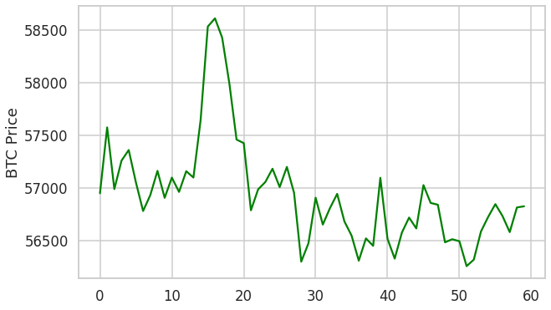
Lets see how this works
We trained an ML model on a several features driven by BTC price.
Market conditions in Nov 2021:

Slide 6
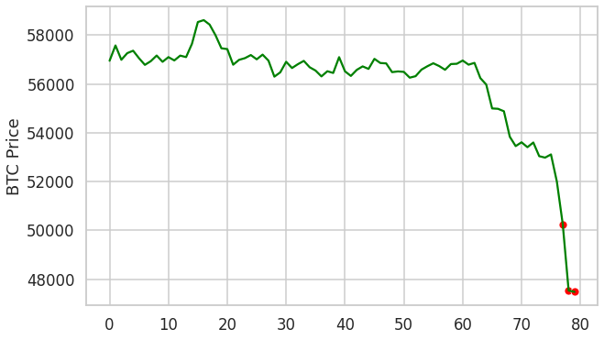
Experiencing the crash with our system

Slide 7
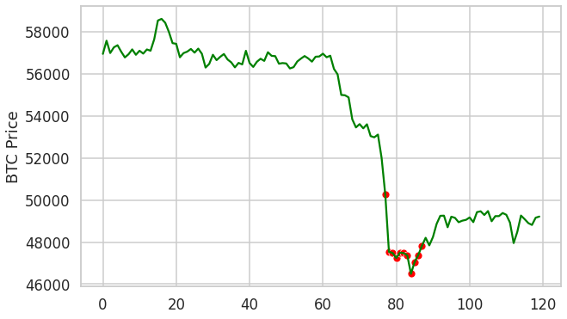
Experiencing the crash with our system

Slide 8
